Slide 1
Performance Measurement and Case Studies at MSN
Paul Roy, Alex Polak, Gregory Bershansky
MSN Performance & Reliability Team
Microsoft
Velocity Web Performance & Operations Conference – June 2011

Slide 2
Performance Mission at MSN
Worldwide scope
48 countries
>500 million users (>100 million new users in last year)
>20 billion monthly page views
Our mission is to make MSN the world’s fastest portal
Driving this mission requires a paradigm shift in
how we measure performance and its impact

Slide 3
Agenda
Measuring performance and its impact
  Performance metrics
  Performance measurement systems
  A/B testing
Performance case studies
Tips & Summary

Slide 4
Performance Metrics
Goal: Performance metrics directly represent a user’s perception
of performance
“Good metrics drive good decisions, bad metrics drive bad decisions”

Slide 5

Our View of Perceived Performance
A user’s perception of web page performance is driven by
two primary factors:
  Rendering time for areas of greatest importance
  Response time to user interactions
Performance metrics need to focus on
Rendering and Responsiveness
Notes:
Why is responsiveness important
Responding to interactions is an integral part of a user’s experience and
satisfaction with the page
Responsiveness is often poor and overlooked

Slide 6

Evolving Performance Metrics at MSN
Past
Today
Current Directions
Header
Ad
Measure download time of all page resources
Measure download time of only visual resources
Measure rendering time and response time
Above Fold Area
Primary metrics
Time to Last Byte
Primary metrics
Time to Visual Content (w/ and w/o ads)
Secondary Metrics
Time to First Byte, Onload,
Page Bottom
Primary metrics
Time to Render
First Render
Above Fold, Header, Ads
Time to Respond
Scroll, Navigate, Search Box interactions, etc.
Directions
Poor representation of perceived performance
Fair representation of perceived performance
Direct representation of perceived performance
Today
Hidden Requests
Past
Internal system view
Human view
Paradigm Shift

Slide 7
Measuring Rendering
What’s possible today
  First Render from tools (HTTPWatch, DynaTrace, etc.)
  First Paint API in IE9 (extension to W3C Web Timing)
  Video analysis solutions (e.g., Webpagetest/Google Above Fold Time)
What we need
  Timings for First Render & Above Fold Render
  Handle video and animated graphics
  Cross-browser solution
  Rendering metrics for different page regions
    Different regions are of varying importance to the user
    E.g., search box, content vs. ads, Facebook News Feed vs. navigation area
  Common methodology for real user & synthetic measurements
  Ease of use
Gap

Slide 8
Measuring Responsiveness
What’s possible today
  #notmuch
What we need
  Methodology, standardization, tools
  Timings related to initial and continuous responsiveness
  Common methodology for real user & synthetic measurements
  Ease of use
Gap

Slide 9
Call to Action
To browser makers
Standardized cross-browser API’s for rendering timings
Whole page and different regions
To community
Research and tools for measuring responsiveness

Slide 10
Measurement Systems
Goal: Comprehensive measurement capability across
Synthetic and RUM systems

Slide 11
Requirements
Engineering Cycle
  Measuring prototypes and internal milestones
  Matrix testing (browsers, OS, hardware, network bandwidth, ...)
  In-depth analysis (traces, counters, profiling, …)
Real-User “Truth”
  Measuring the real user experience
Rendering and Responsiveness
  Measuring rendering and responsiveness
Geo-Distributed Infrastructure
  Measuring global data center and network topology
Competitive
  Measuring competitor pages

Slide 12
Measurement Systems at MSN
Synthetic
Real User Measurement (RUM)
  Performance Lab
  3rd Party Agents (Keynote)
  In-page & Server-side instrumentation
  Browser Plug-in (toolbar)
 | Performance Lab | 3rd Party Agents | In-Page | Browser Plug-in
Engineering Cycle
Real-User “Truth”
Rendering & Resp.
Geo-Distributed Infrastructure
Competitive
Call to Action (earlier slide)

Slide 13
A/B Testing
Impact on business metrics is the ultimate truth of whether a
change is worthwhile

Slide 14
Measuring Business Impact at MSN
A/B testing used to evaluate a change’s impact on business metrics
  Subsets of user population receive different behavior/experiences
  Control group vs. treatment group(s)
  Statistical power obtained through very large sample size
MSN business metrics (subset)
  Page Views, Page Clicks, Page CTR
  Searches to Bing
  Ad Impressions, Ad Clicks, Ad CTR
  User satisfaction

Slide 15
Measuring Business Impact at MSN (cont.)
Small % improvements to business metrics make a difference in the aggregate
Even more so on an absolute basis at high scale
  MSN: >20 billion monthly page views worldwide
  1% improvement = >200 million page views
  Performance metrics need to be excellent proxies for business metrics
    Enables prediction of how a change will affect the business

Slide 16
Performance Case Studies
What worked….What didn’t
Caveat: your mileage may vary

Slide 17
Case Study : Asynchronous jQuery Load
Situation
Page developers like using jQuery
jQuery loaded synchronously from the head (v1.4.2; 25KB compressed; loaded from CDN)
Blocks rendering, and download initiation of other assets (lesser so for newer browsers)
Negative effect will increase over time as jQuery continues to grow....
jQuery v1.6: 229KB uncompressed (31KB compressed)

Slide 18
Case Study : Asynchronous jQuery Load (cont.)
What We Did
Load jQuery asynchronously
Use small “Early Stage JS” library for capabilities needed immediately (6KB loaded inline)
  Usage tracking, Async loading, Event handling, DOM reading
Zero net size increase to inline JS (some code moved to external file, offsetting 6KB increase)
Impact
Takeaways
Loading jQuery synchronously hurts the business
Note….jQuery is on 45% of the top one million web sites*….
*Source: http://trends.builtwith.com/javascript, 6/7/2011
Time to First Render | Time to Onload | Search Clicks | Page Clicks
200-300ms gain | 250ms gain | +0.5% | +0.5%

Slide 19
Case Study : Improving JS Execution Time
Situation
Long running JS at page bottom (binds behavior to UI elements)
What We Did – three rounds of changes in succession (additive):
Change #1 – reduce total JS execution time
Change #2 – defer some JS execution to scroll event (for below-fold bindings)
Change #3 – defer more JS execution by 1s (for less-critical bindings)
Impact
Takeaways
Long running JS hurts the business
  Impacts responsiveness (First Render not impacted)
Open question:
  Where is the point of diminishing return for reducing JS execution time?
Change | CPU Impact | Search Clicks | Page Clicks
#1 | 400ms gain (1050->650,~40%) | +1.2% | +0.5%
#2 | 200ms gain (650->450, ~30%) | +0.5% | None
#3 | 100ms gain (450->350, ~20%) | None | None

Slide 20

Case Study: Delayed Ad Loading
Situation
Core content loaded first, with ads immediately following (some overlap)
Big Upper
Right Ad

Slide 21
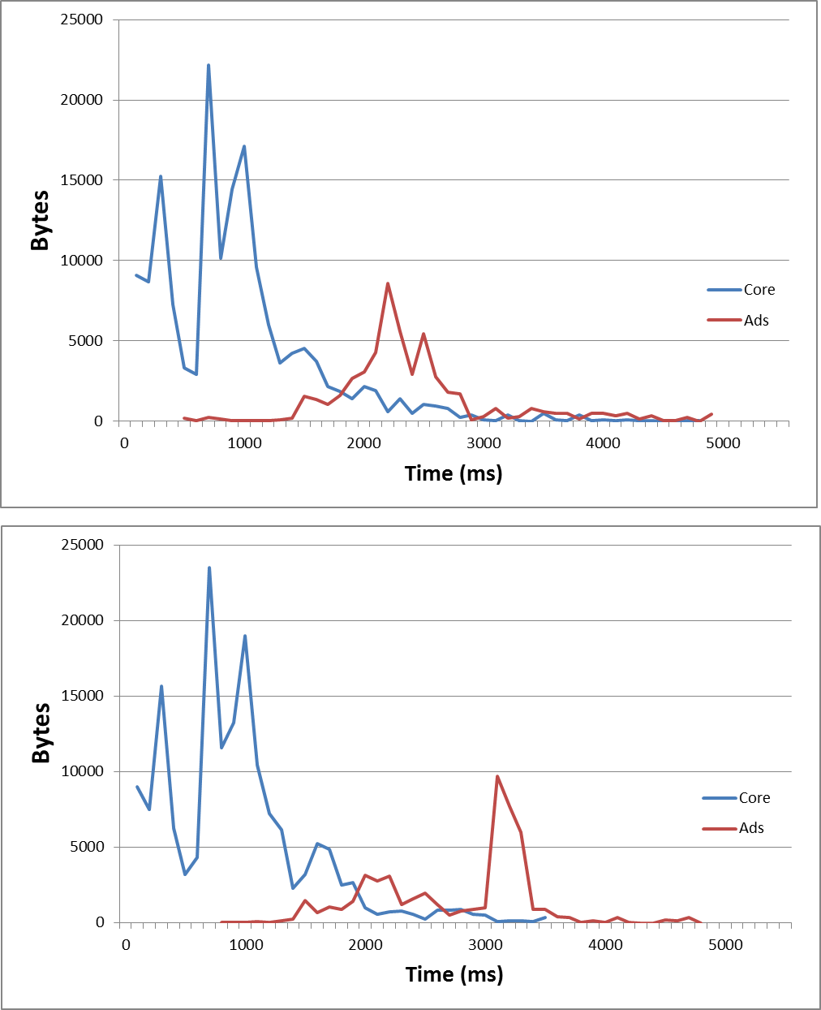
Case Study: Delayed Ad Loading (cont.)
What We Did
Delayed loading of the Big Upper Right Ad by 1s
Bandwidth utilization charts
Blue line – core content (HTML, CSS, JS, images)
Red line – ads (JS lib, ad platform calls, creatives)
Impact
Helped performance and some business metrics, but dramatically hurt Ad business metrics
  => Net lose for the business
Takeaways
Seek sweet spot for ad loading that yields a win-win
Before
Time to Page Bottom | Time to Onload | Page Clicks | Page Views | Ad Click Thru Rate
80ms gain | 500ms gain | +0.5% | +0.4% | -15%
After
Notes:
Heaviest part of ad loading pushed out. Lib, smaller ads not pushed out.
Some improvement to tail of core, due to less overlap of Core and Ads

Slide 22
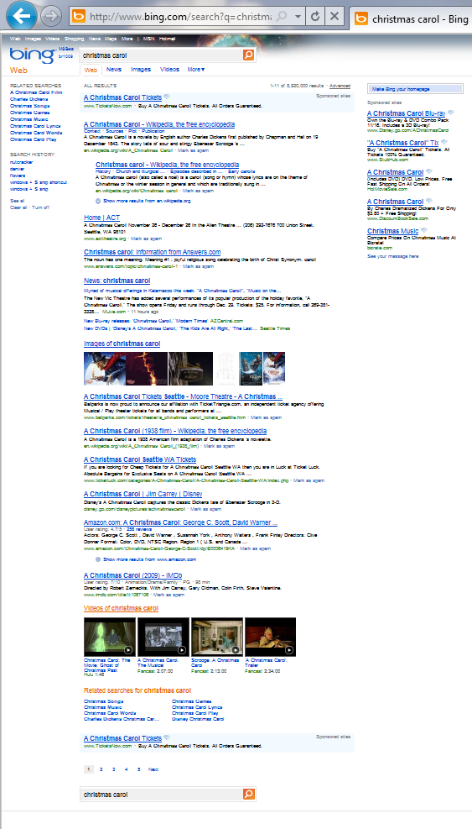

Case Study: Embedding Thumbnails
Contributor: Mujtaba Khambatti (Bing Performance Team)
Situation
Thumbnails on Bing Search Results Page incur extra round-trips, and rendering delay relative to rest of page
Note: thumbnails have low cache hit rate
What We Did
Use Data URI’s to embed thumbnails within base page
  At end of HTML (with chunked transfer encoding) to avoid blocking rendering of textual content
Eliminates round-trips and extra TCP connection
Impact
Takeaways
Embedding low cache hit rate images helps the business (especially images above the fold)
Time to Onload | Session Success Rate (% of search sessions with a click)
200-500ms gain (depends on # of thumbnails) | +0.7%

Slide 23
Tips & Summary

Slide 24
Driving the Performance Mission
Secure air cover
  Get executives bought into the performance mission (prove to them the business value)
Recruit the engineers
  Make every engineer an improvement-maker (not just a few select gurus)
Arm the engineers
  Great performance metrics, statistically representative
  Synthetic and RUM measurement systems
  A/B testing
Permeate
  Drive the mission upstream into the engineering process (and downstream after shipping)
Win the hearts and minds
  Help stakeholders see that it's possible to have performance AND richness (within reason)
Drive the mission with committed goals
  Accountabilities are a big lever

Slide 25
Summary
Performance metrics need to focus on rendering and responsiveness, and need to be excellent proxies for business metrics
A/B testing is critical
  Impact on business metrics is the ultimate truth of whether a change is worthwhile
Call to Action – to browser makers
  Standardized cross-browser API’s for rendering timings
Call to Action – to community
  Research and tools for measuring response time

